Slide 1

VaultX Bank Simulator
Mohit Kadam 24207003
Sakshi Salve 24207007
Dhruvraj Wankhede 24207009
Agrima Gupte 24207019
Project Guide
Ms. Rajashri Chaudhri

Slide 2
Contents
Introduction
Objectives
Features
Built in functions used
Block Diagram
Output Screenshots

Slide 3
1. Introduction
The ATM Simulator Project is a desktop-based banking simulation application designed to replicate core ATM operations. Developed using Java AWT, Swing, and MySQL, the project enables users to perform functions like account creation, balance inquiry, deposits, withdrawals, and transaction receipts.
The application integrates a secure user authentication system, and all financial operations are reflected in real-time within the MySQL database.
This project serves as an educational tool to understand how banking systems function, focusing on user interface development, database management, and transaction handling.

Slide 4
2. Objectives
1. User authentication and account management: Implement a secure login and signup system where users can register or login into their accounts. User data should be securely stored and authenticated using a MYSQL Database.
2. Atm Operations Simulation: Simulate all basic ATM functions (balance enquiry, withdrawal, deposit and fund transfer) that real ATMs offer.
3. Database Integration: Ensure all user operations such as deposits, withdrawals and transfer are reflected and updated in real time in MYSQL database.
4. Transaction Login: Record each transactions, including the type and amount, into database for future reference and audit purposes.

Slide 5
4. Feature
Secure user authentication and account management system.
Simulate ATM operations: balance inquiry, deposits, withdrawals.
Real-time database integration with MySQL for transaction updates.
4. User-friendly Java AWT and Swing-based graphical interface.
5. Option to generate transaction receipts for user records.

Slide 6
3. Built in functions used (Not applicable for OOPJ project)
AWT & Swing Methods: Used to create the graphical user interface (GUI) for buttons, forms, and text fields (e.g., JButton(), JTextField(), JFrame()).
Database Connectivity (JDBC): Functions like DriverManager.getConnection(), Statement.executeQuery() are used for establishing and executing queries to MySQL.
String and Integer Operations: Built-in Java functions for parsing and handling user inputs, such as Integer.parseInt(), String.equals().
Date and Time Functions: For logging transactions with timestamps, using java.util.Date and java.sql.Timestamp.

Slide 7
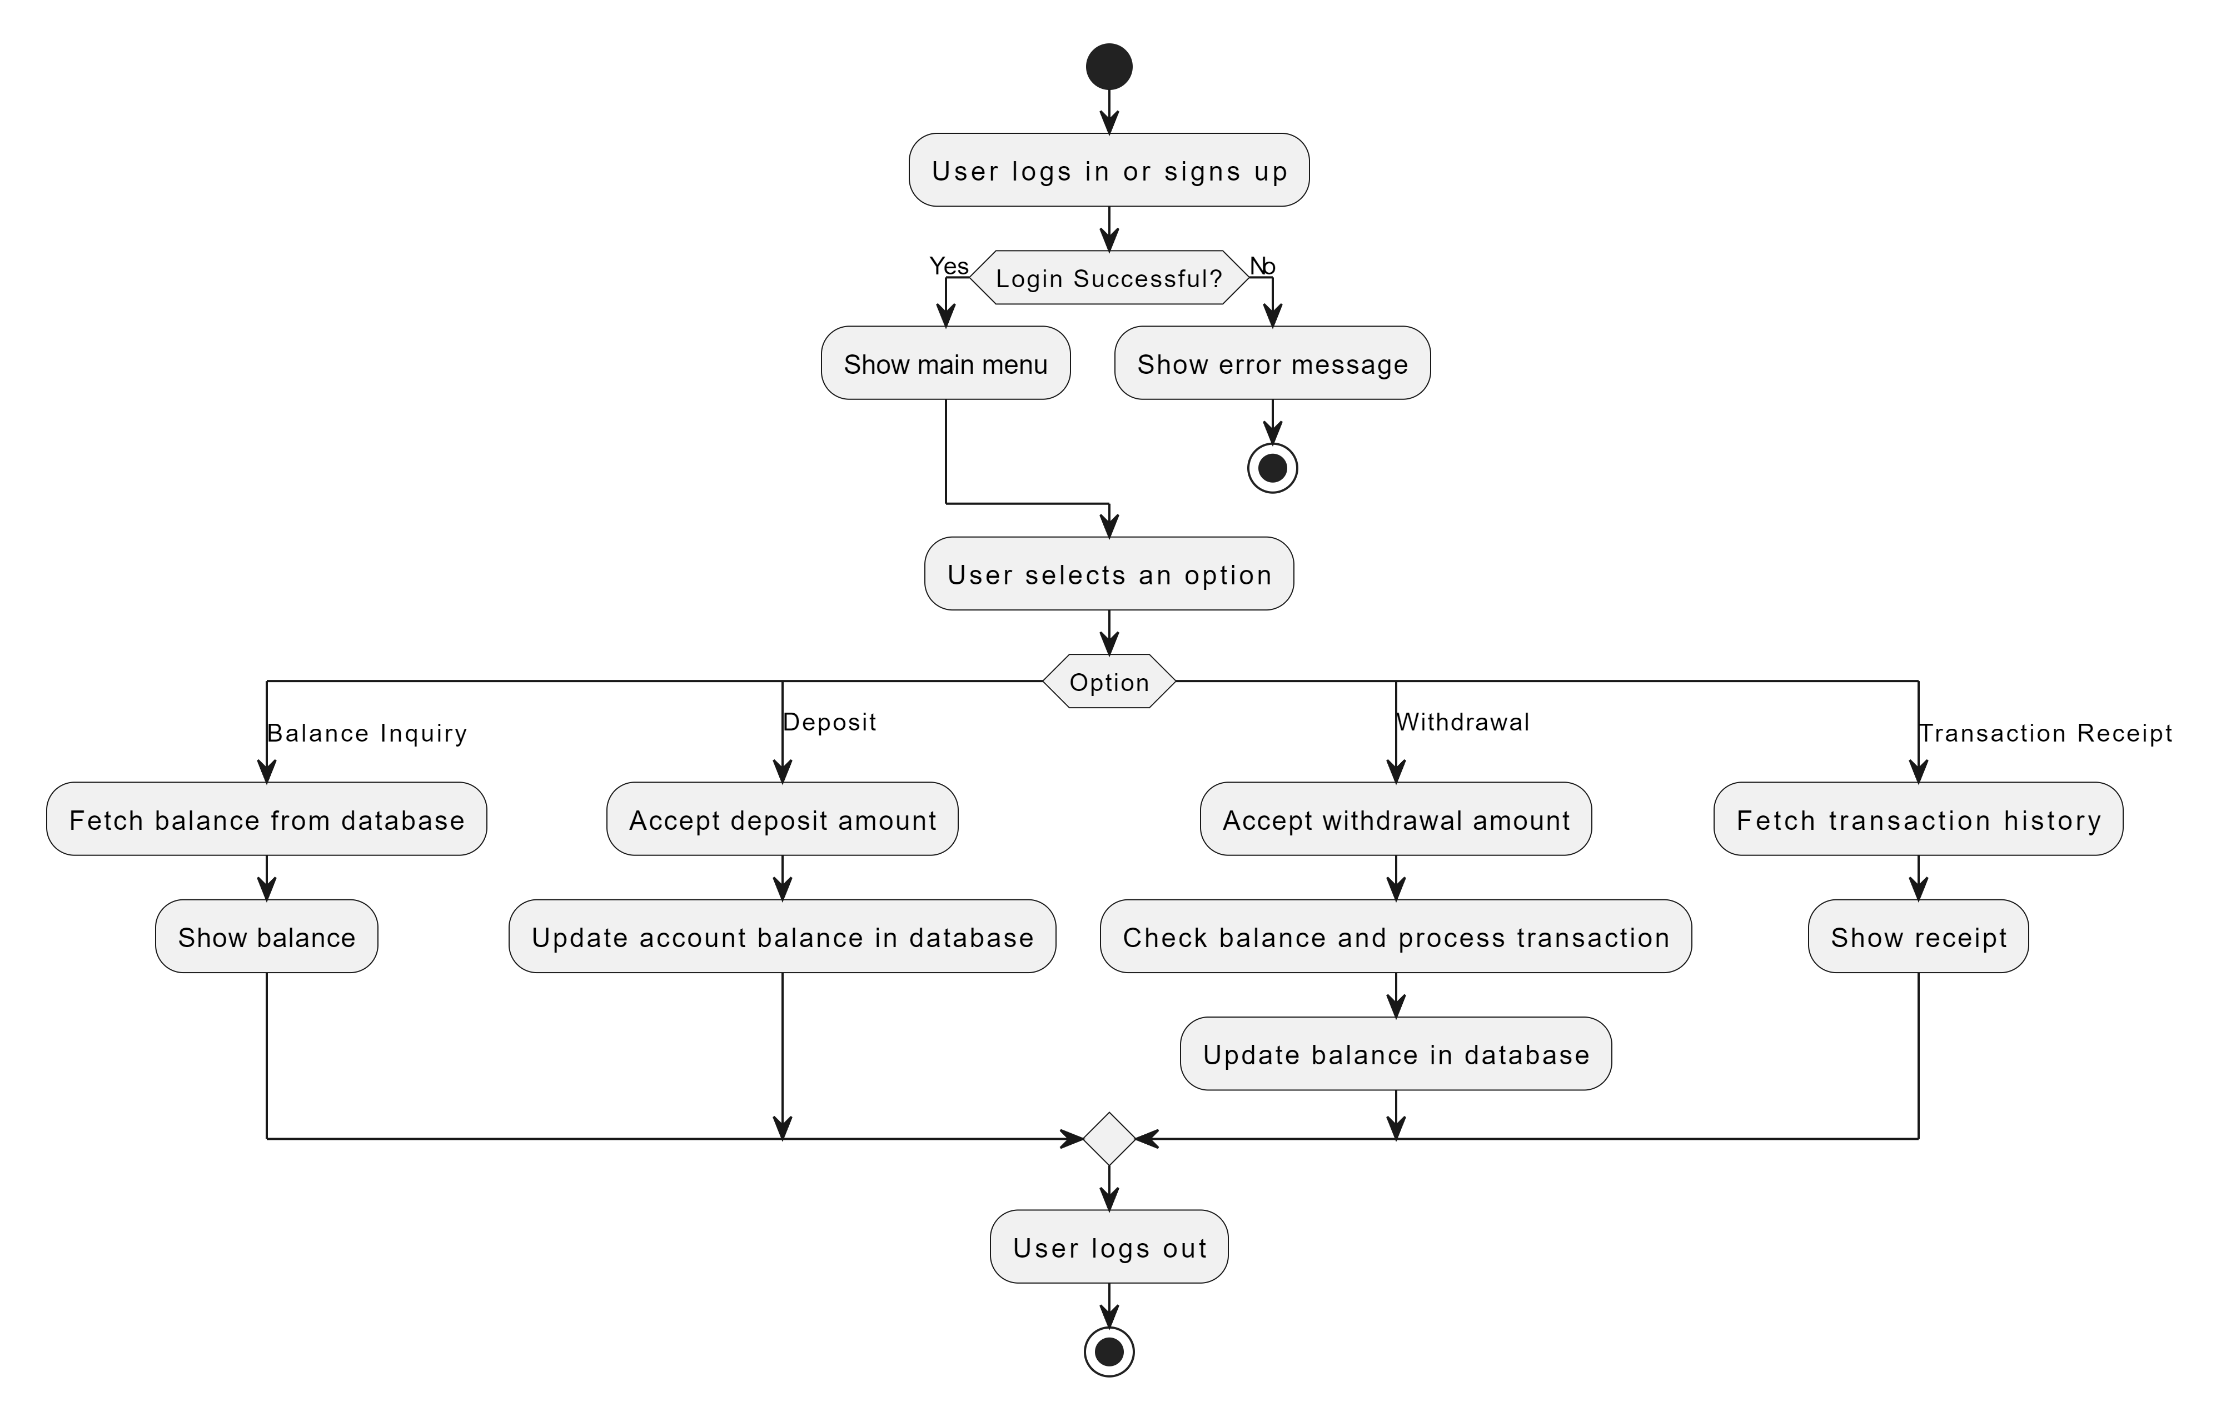
7. Block Diagram/ Flow diagram

Slide 8
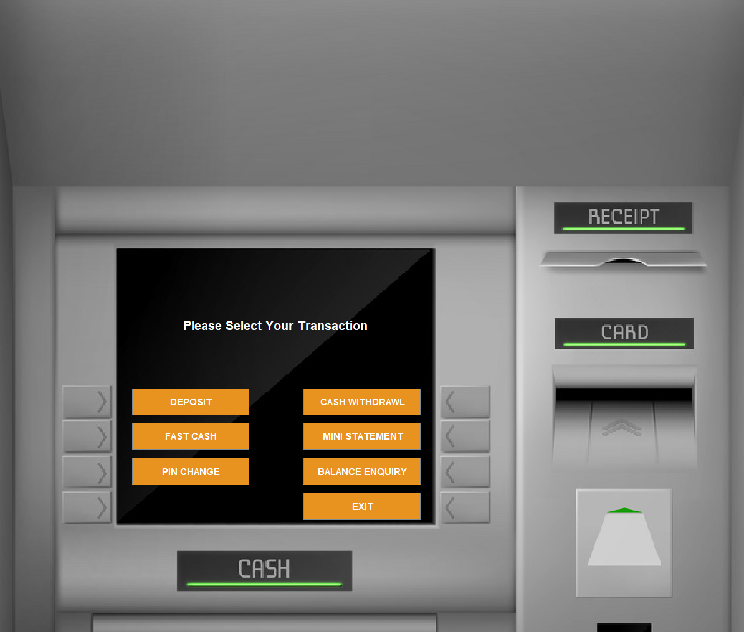
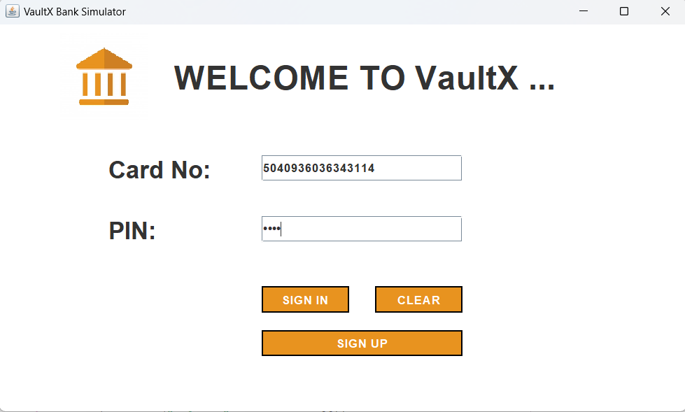
5. Output of Project
Add screenshot of output window

Slide 9
Thank You...!!

